Slide 2
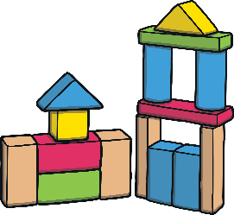


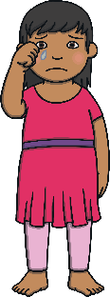
Touching My Belongings
Belongings are items that belong to someone.
I take my belongings into school.
What kind of belongings do you bring to school?
Sometimes I touch my friend’s belongings. This might make them sad.

Slide 3
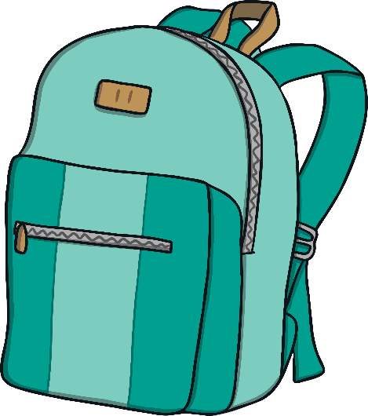
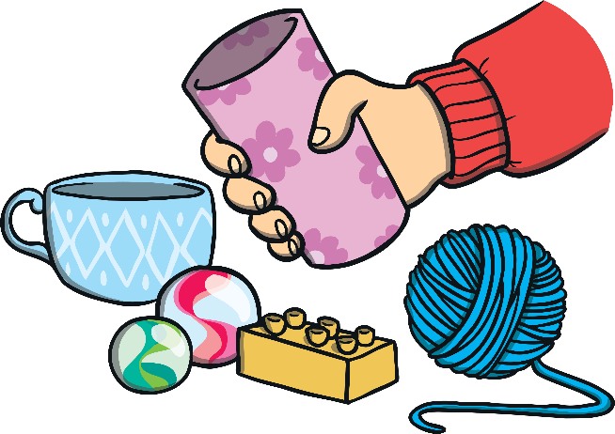

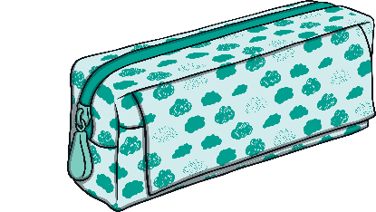
What Should I Do?
I will only touch
my belongings.
I will touch or grab all of the things that belong to my friend.

Slide 4
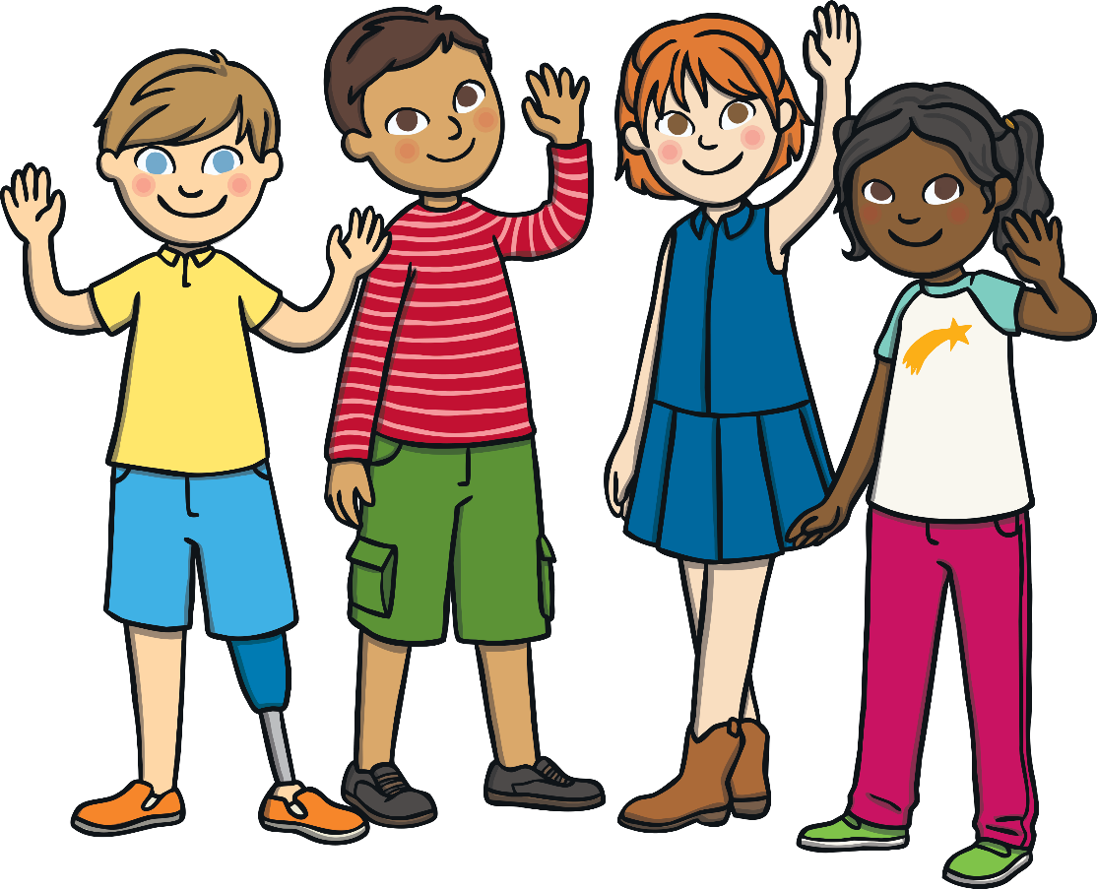
Well Done! Great Choice!
I can remember to only touch my own belongings.
I can:
put my hands on my knees;
cross my arms;
think about how touching
my friend’s things might
upset them;
stay away from my
friend’s belongings.
My teacher can help me
with this.
This will make my friends
and teachers happy.

Slide 5
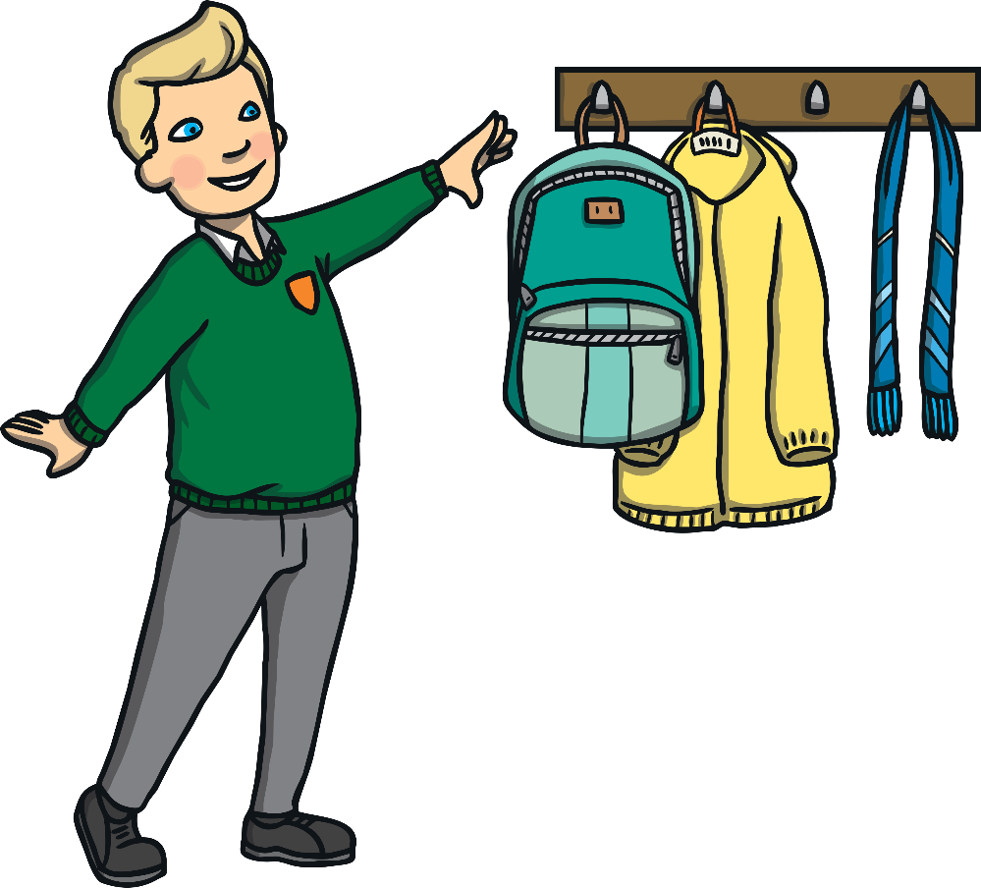
Hmmm... Let’s Think About What Happens If We Touch Other People’s Belongings
If we touch other people’s
belongings, we can annoy and
upset them. This might make our
teachers or friends feel sad.
We might get into trouble.
How would you feel if your friend
touched your things and you did
not like it?

Slide 6

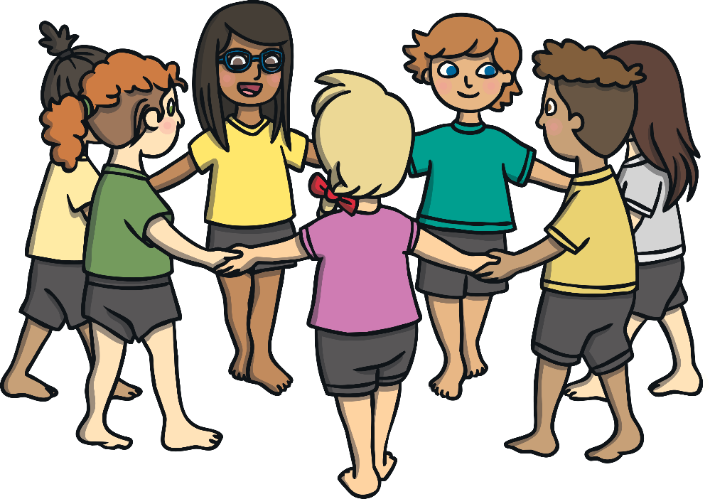
Touching My Belongings
I will try to remember not to touch other
people’s belongings.
It is OK for me to touch my belongings.
They belong to me.
My teacher will help me with this.
My friends will feel happy.

